Slide 1



Site Provisioning using app model

Slide 2
Introduction to provisioning options

Slide 3
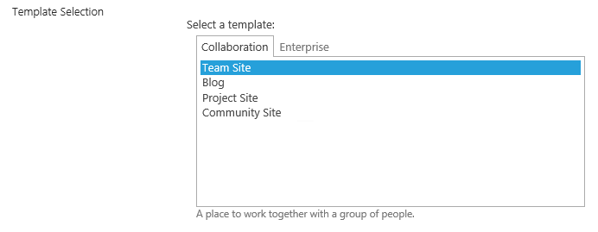
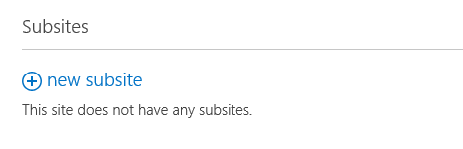

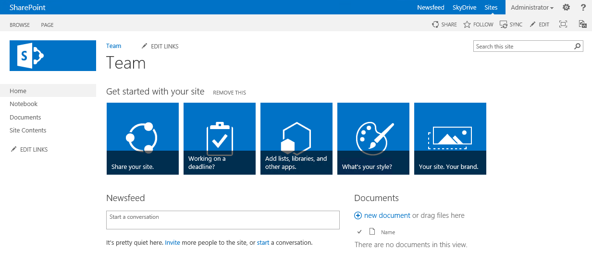

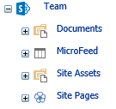

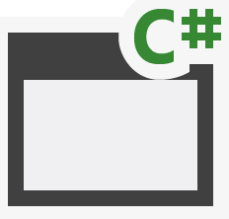

Feature Stapling Modify oob site definition provisioning model
2
3
15\Template\Features\ [StaplerFeature]
element.xml
1
<xml>
15\Template\Features\[StapledFeature]\
4
feature.xml
<xml>
<xml>
Notes:
Show site options based on web temp files in the 15 template folder. Notice that each language has it’s own web temp folder, which is created when language pack is installed.
When template is selected, onet.xml from the corresponding folder is executed and site provisioning is started based on that file.
Features mentioned in the onet.xml are activated in the order of their presence and each feature has their own feature.xml with element.xml files that is processed.
Dependent features are activated before features in the onet.xml are activated. Features can also activate other features programmatically from feature receiver.
After site scope feature activation and web scope feature activation, corresponding stapled features are activated for each scope, which have their own xml configuration. These features can also have dependencies and other activations.
After all features have been activated, possible list instances and modules are provisioned from the onet.xml and site is ready to be used by end users.

Slide 4
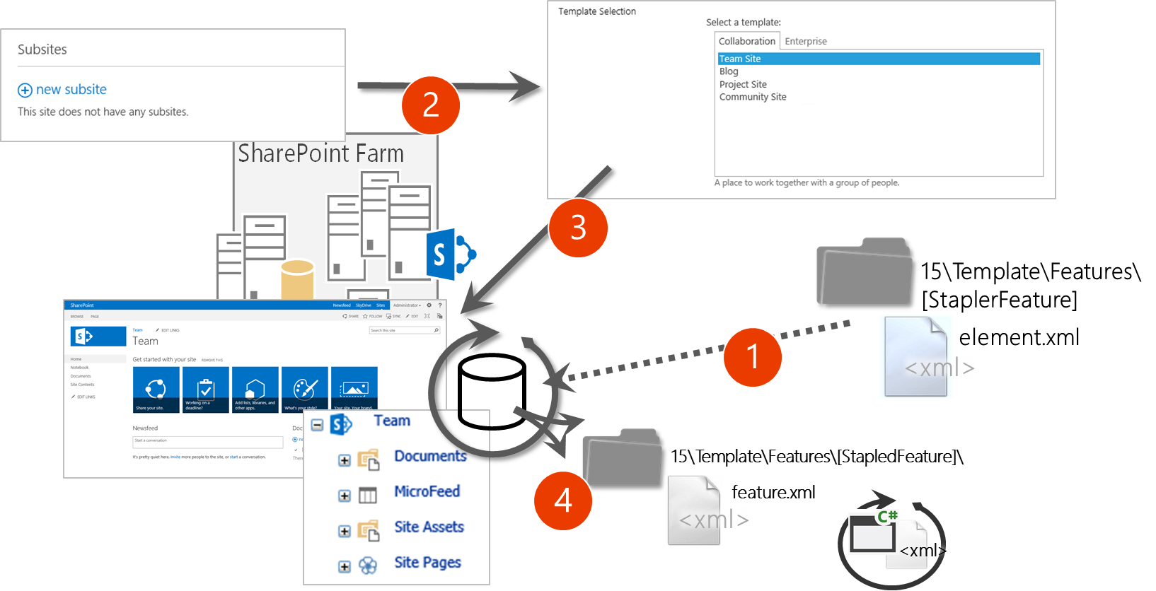
Feature Stapling Modify oob site definition provisioning model
Key objective
Extend site provisioning with out–of–the–box site definitions
Challenge
Cannot be used to bring new template options
Only available in Office365 at site collection scope, so not really an option in Office365 development
Notes:
Title: Feature Stapling Length: 1 min.
Key objective
Extend site provisioning with out–of–the–box site definitions
Challenge
Cannot be used to bring new template options
Only available in Office365 at site collection scope

Slide 5
Site Definition Provisioning Process Classic template system available since 2003 or 2007
15\Template\[lcid]\xml
WebTemp*.xml
1
<xml>
2
15\Template\SiteTemplates\[selection]\xml
onet.xml
<xml>
15\Template\Features\[FeatureName]\
3
feature.xml
<xml>
<xml>
15\Template\Features\[StapledFeature]\
4
feature.xml
<xml>
<xml>
Notes:
Show site options based on web temp files in the 15 template folder. Notice that each language has it’s own web temp folder, which is created when language pack is installed.
When template is selected, onet.xml from the corresponding folder is executed and site provisioning is started based on that file.
Features mentioned in the onet.xml are activated in the order of their presence and each feature has their own feature.xml with element.xml files that is processed.
Dependent features are activated before features in the onet.xml are activated. Features can also activate other features programmatically from feature receiver.
After site scope feature activation and web scope feature activation, corresponding stapled features are activated for each scope, which have their own xml configuration. These features can also have dependencies and other activations.
After all features have been activated, possible list instances and modules are provisioned from the onet.xml and site is ready to be used by end users.
For more information see: Site provisioning techniques and remote provisioning in SharePoint 2013
http://blogs.msdn.com/b/vesku/archive/2013/08/23/site-provisioning-techniques-and-remote-provisioning-in-sharepoint-2013.aspx

Slide 6
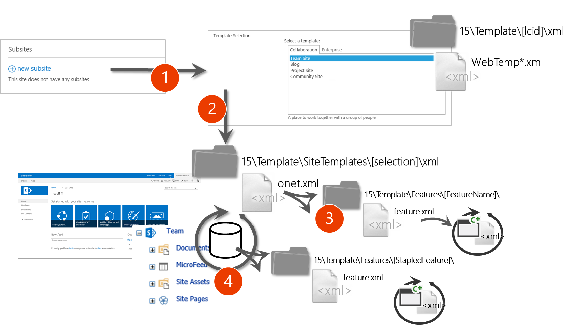
Site Definition Provisioning Process Classic template system available since 2003 or 2007
Key objective
Provide new site options to be available for end users
Same capabilities as for out–of–the–box site definitions
Challenge
Impacts on major version upgrade
Is not and cannot be supported in Office365
Deployed in farm level

Slide 7
Web Template Provisioning Process Introduced in 2010 initially for site templates, but can be also created “manually”
15\Template\Features\ [FeatureName]
element.xml
1
<xml>
2
15\Template\Features\[FeatureName]
15\Template\SiteTemplates\[selection]\xml
onet.xml
onet.xml
3
<xml>
<xml>
15\Template\Features\[FeatureName]\
feature.xml
<xml>
No stapled features are activated with Web Templates, which could cause significant differences compared to out–of–the–box sites initially and after product updates.
<xml>
4
Notes:
Title: Web Template Provisioning Process Length: 2 min.
Show site options based on activated features with Web Template element either from farm or site scope.
When template is selected, onet.xml from the corresponding feature is executed and site provisioning is started based on that file.
Features mentioned in the onet.xml are activated in the order of their presence and each feature has their own feature.xml with element.xml files that is processed.
Dependent features are activated before features in the onet.xml are activated. Features can also activate other features programmatically from feature receiver.
After all features have been activated, possible list instances and modules are provisioned from the onet.xml and site is ready to be used by end users.
It’s important to notice that stapled features are NOT activated, which could cause huge differences between oob sites and custom templates if it is not taken into account in initial development and ALSO during upgrades that are applied to SharePoint.

Slide 8
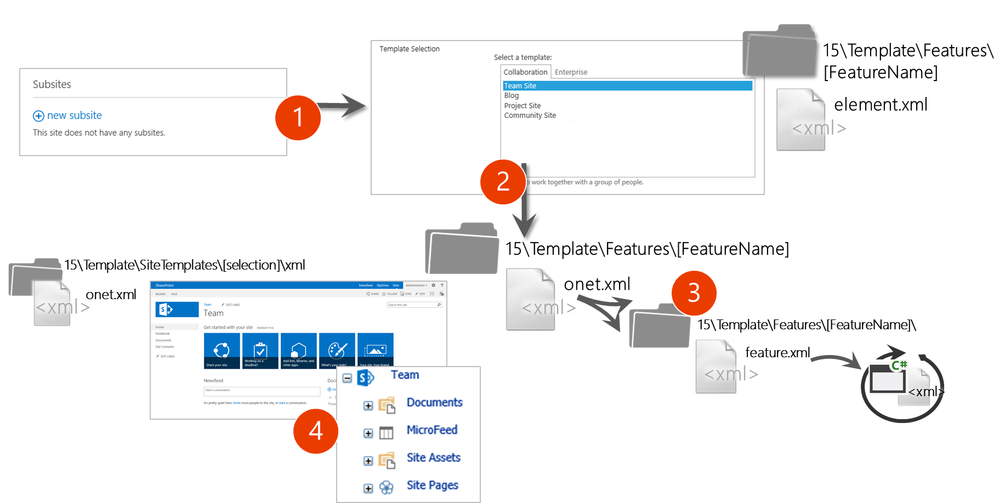

Web Template Provisioning Process Introduced in 2010 initially for site templates, but can be also created “manually”
Key objective
Provide new site options to be available for end users
Site associated to out–of–the–box site definition
Challenge
Have to be updated with minor version updates to the farm
Causes significant maintenance challenges due complete replacement of oob site definition
Supported in site collection level in Office365
Notes:
Title: Web Template Provisioning Process Length: 1 min.
Key objective
Provide new site options to be available for end users
Site associated to out–of–the–box site definition
Challenge
Have to be updated with minor version updates to the farm
Causes significant maintenance challenges due complete replacement of oob site definition
Supported in site collection level in Office365

Slide 9
Maintenance Challenge With Web Template
Web Template onet.xml is created by copying team site onet.xml and by adding stapled features to onet.xml.
Significant differences on the outcome unless web template onet.xml has been updated cross site collections with the changes that were also done for out of the box team site.
onet.xml
onet.xml
onet.xml
<xml>
X feature activations
<xml>
X feature activations
<xml>
X feature activations
<< Copy >>
Custom Web Template
Team Site
onet.xml
onet.xml
onet.xml
<xml>
X feature activations
<xml>
X feature activations +2
<xml>
X feature activations +4
Time
Service updates for introducing new capabilities to team sites also using feature stapling.

Slide 10
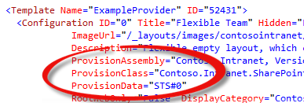
Site Provisioning Provider Process Available since 2007, but not widely used
15\Template\[lcid]\xml
2
WebTemp*.xml
1
<xml>
3
15\Template\SiteTemplates\[selection]\xml
<xml>
onet.xml
4
<xml>
Notes:
Show site options based on web temp files in the 15 template folder. Notice that each language has it’s own web temp folder, which is created when language pack is installed.
When template is selected, onet.xml from the corresponding folder is executed and site provisioning is started based on that file.
Features mentioned in the onet.xml are activated in the order of their presence and each feature has their own feature.xml with element.xml files that is processed.
Dependent features are activated before features in the onet.xml are activated. Features can also activate other features programmatically from feature receiver.
After site scope feature activation and web scope feature activation, corresponding stapled features are activated for each scope, which have their own xml configuration. These features can also have dependencies and other activations.
After all features have been activated, possible list instances and modules are provisioned from the onet.xml and site is ready to be used by end users.

Slide 11
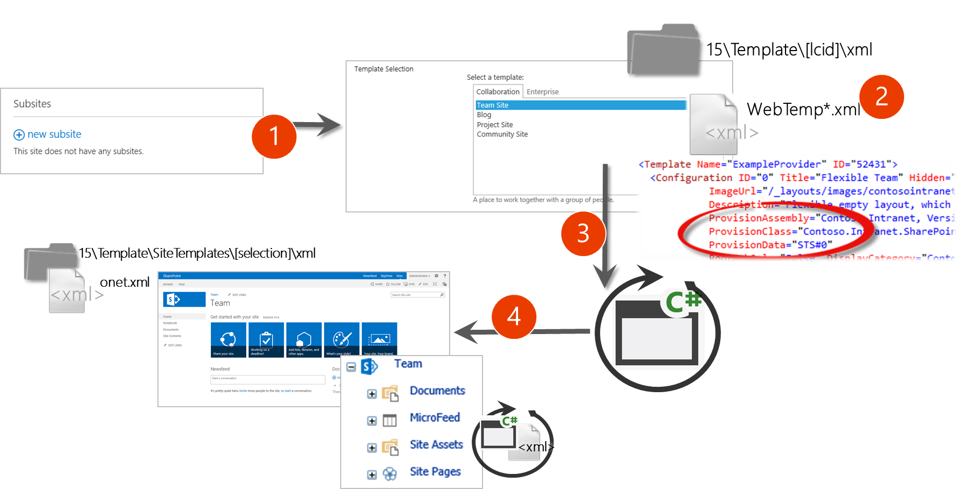
Site Provisioning Providers Available since 2007, but not widely used
Key objective
Introduce new site creation options for end users to the create site capability
Can take advantage of creating sites based on out–of–the–box site definitions and then modify them based on requirements
Challenge
Not supported in Office365
Requires full trust code
Notes:
Title: Site Provisioning Providers Length: 1 minute
Key objective
Introduce new site creation options for end users to the create site capability
Can take advantage of creating sites based on out–of–the–box site definitions and then modify them based on requirements
Challenge
Not supported in Office365
Requires full trust code

Slide 12





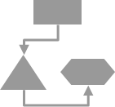
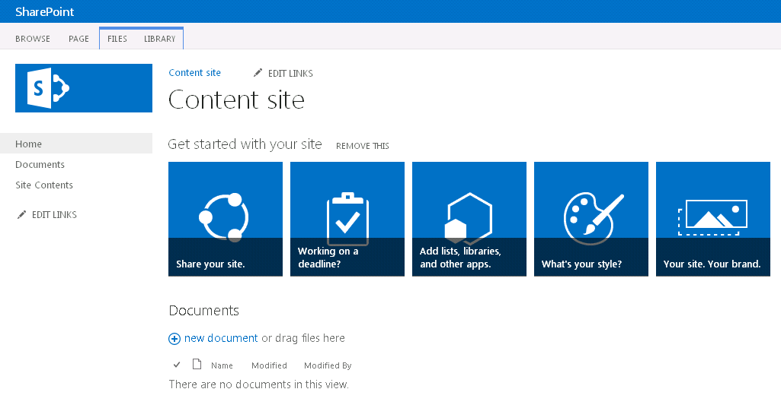

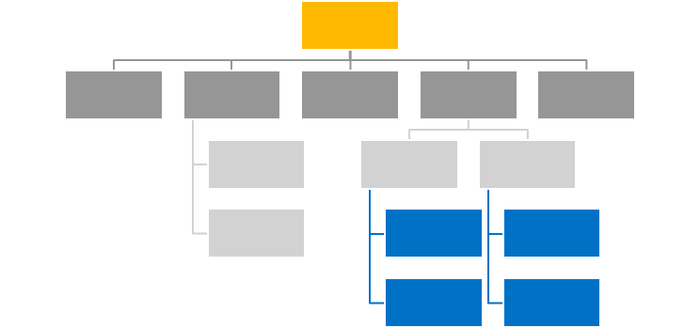
Full Custom Solutions Common solution for custom self-service site collection creation
Self service site collection
http://
Site Title
3
text
Description
2
1
URL
Type
Team
Community
Project
Site collection administrator
”by default current user”
Secondary administrator
4
”by default current user”
<xml>
6
Timer job
5
http://teams.contoso.com /sites/site

Slide 13
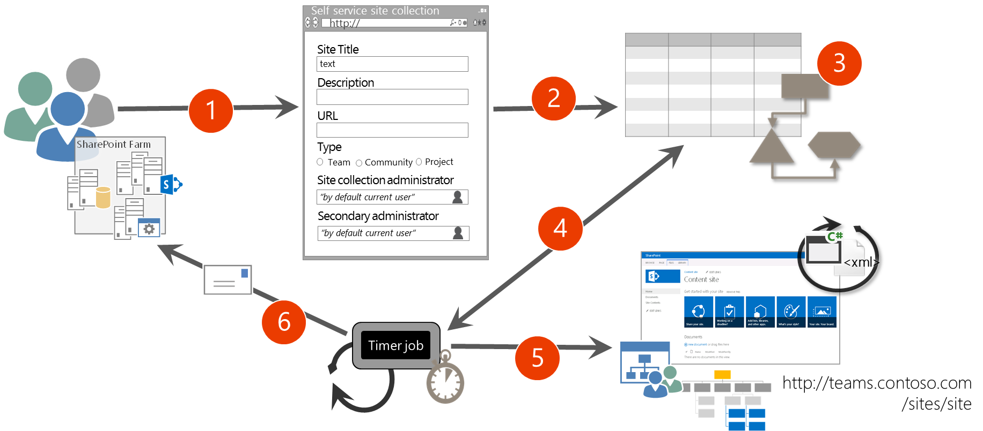
Full Server Side Custom Solutions Common solution for custom self service site collection creation
Key objective
Provide self service and polished site collection creation opportunity for end users
Can be extended with workflows and timer jobs
Challenge
Not supported in Office365
Requires full trust code
Can be complex to setup and maintain
Notes:
Title: Full Server Side Custom Solutions
Length: 2 minutes

Slide 14
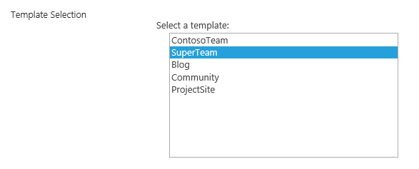

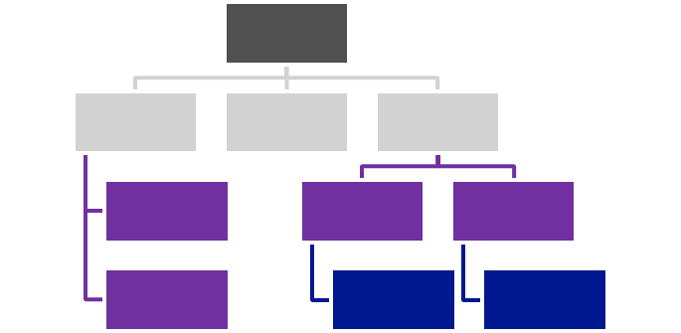
Remote Provisioning Process
1
2
CSOM / REST
4
5
Own app specific configuration
<xml>
Artefacts
3
Notes:
For more information see: Site provisioning techniques and remote provisioning in SharePoint 2013
http://blogs.msdn.com/b/vesku/archive/2013/08/23/site-provisioning-techniques-and-remote-provisioning-in-sharepoint-2013.aspx

Slide 15
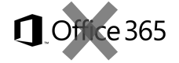
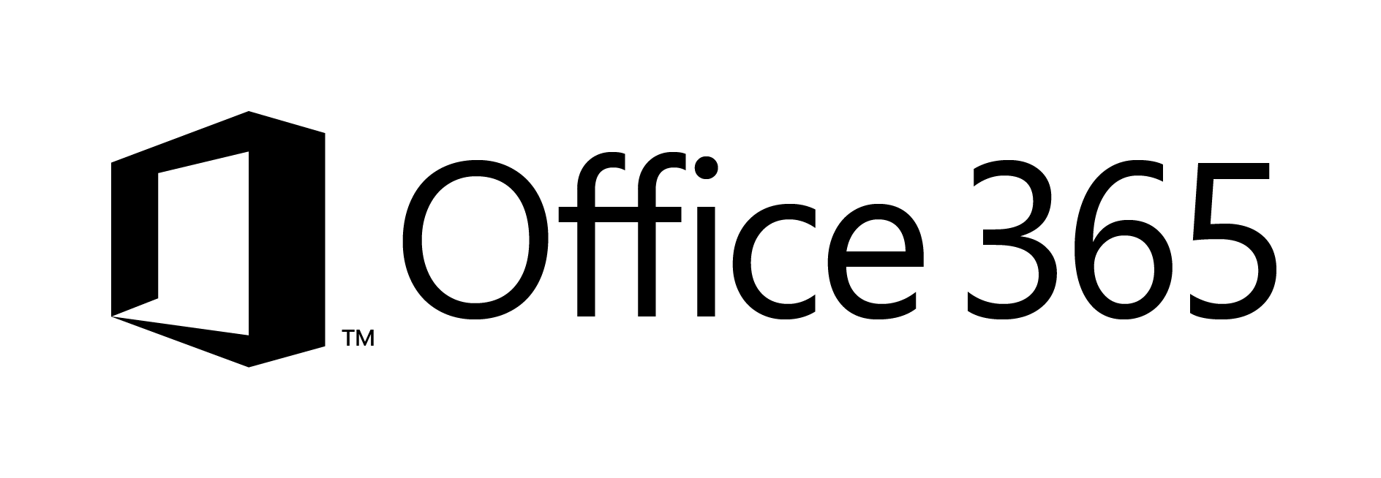
Site Provisioning Options/Comparison
Site Definition
Site Templates
Web Templates
SP Server side provisioning
Remote provisioning
No Office365
Long term impact on costs
Blocks transition to cloud
Causes significant issues with future migration and upgrade
Poor site collection creation story
Negative impact on upgrades
Causes additional maintenance costs with evergreen
Not with publishing features
Poor site collection creation story
Causes maintenance costs with evergreen
Provision oob sites, but modify them based on user selection and requirements
Standardization of site creation in code
No Office365
CSOM supports creation of site collections only in Office365
Standardization of site creation in code
Can be done from any external system
Options
Support in cloud
Options available
Poor
Fair
Average
Good
Excellent
Cost impact (short and long term)
Notes:
For more information on provisioning sites and associated terminology see:
SharePoint 2010 and web templates, http://blogs.msdn.com/b/vesku/archive/2010/10/14/sharepoint-2010-and-web-templates.aspx
Site provisioning techniques and remote provisioning in SharePoint 2013, http://blogs.msdn.com/b/vesku/archive/2013/08/23/site-provisioning-techniques-and-remote-provisioning-in-sharepoint-2013.aspx

Slide 16
Create site collections

Slide 17

Site Collection Creation from Apps
What
Provision new site collections from app side
Why
Can be used to override out–of–the–box self-service site collection creation form
Can be used to integrate additional functionalities as part of the provisioning
How
Office365 has separate downloadable that includes the needed CSOM elements to provision sites
Before 2014 April CU, not natively supported in on-premises

Slide 18
Site Collection Creation with Apps
SharePoint Online
Download and install SharePoint Online Client Components SDK for enabling the site collection creation
Add reference to Microsoft.Online. SharePoint.Client.Tenant assembly for accessing the needed APIs
Use SiteCreationProperties object for actually creating the site collection
On-Premises
Pre-April 2014 CU
Create new WCF end point to the on-premises farm to enable site collection creation remotely
Call the end point from the app with needed parameters to provision site collection
Post April 2014 CU
Enable server side stub for site collection creation
Use Tenant object like with SharePoint Online
Notes:
For more information see: Create a site collection in SharePoint 2013, http://technet.microsoft.com/en-us/library/cc263094(v=office.15).aspx

Slide 19
Example Code to Create a Site Collection
//Create site collection using the Tenant object
var webUrl = String.Format("https://{0}.sharepoint.com/{1}/{2}", tenantStr, templateConfig.Attribute("ManagedPath").Value, txtUrl);
var tenantAdminUri = new Uri(String.Format("https://{0}-admin.sharepoint.com", tenantStr));
string realm = TokenHelper.GetRealmFromTargetUrl(tenantAdminUri);
// Using app only token, so that
var token = TokenHelper.GetAppOnlyAccessToken(TokenHelper.SharePointPrincipal, tenantAdminUri.Authority, realm).AccessToken;
using (var adminContext = TokenHelper.GetClientContextWithAccessToken(tenantAdminUri.ToString(), token))
{
var tenant = new Tenant(adminContext);
var properties = new SiteCreationProperties()
{
Url = webUrl,
Owner = currUser.Email,
Title = title,
Template = siteTemplate,
StorageMaximumLevel = 100,
UserCodeMaximumLevel = 100
};
//start the SPO operation to create the site
SpoOperation op = tenant.CreateSite(properties);
adminContext.Load(tenant);
adminContext.Load(op, i => i.IsComplete);
adminContext.ExecuteQuery();
//check if site creation operation is complete
while (!op.IsComplete)
{
//wait 30seconds and try again
System.Threading.Thread.Sleep(30000);
op.RefreshLoad();
adminContext.ExecuteQuery();
}
}

Slide 20
Site Collection Creation On-Premises with apps Before 2014 April CU
1
3
Custom WCF Service
<xml>
4
CSOM / REST
Own app specific configuration
2
Artifacts
Notes:
Unless April CU 2014 has been installed, you would need additional extension to enable site collection provisioning in on-premises.

Slide 21

Site collection creation on-premises CSOM Post 2014 April CU
1
3
CSOM / REST
<xml>
Own app specific configuration
Artefacts
2
Notes:
UI for the end users to select the type of the template and to typically set additional metadata for the created site
Detailed configuration and options are dependent on the provider hosted app side. Typically we have configurations to provide theme or custom master page to the selected template together with some additional elements
Actual provisioning of the site collection using CSOM. You can use CSOM or REST for additional configurations

Slide 22
Asynchronous provisioning model Request, store, approve, process, inform
2
1
3
4
6
<xml>
Remote Timer job
5
http://teams.contoso.com /sites/site

Slide 23
Real life enterprise implementation
3
1
2
AD/DC
4
5
CSOM / REST
FIM
<xml>
6
Own app specific configuration
Artefacts

Slide 24
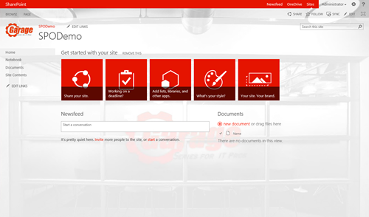
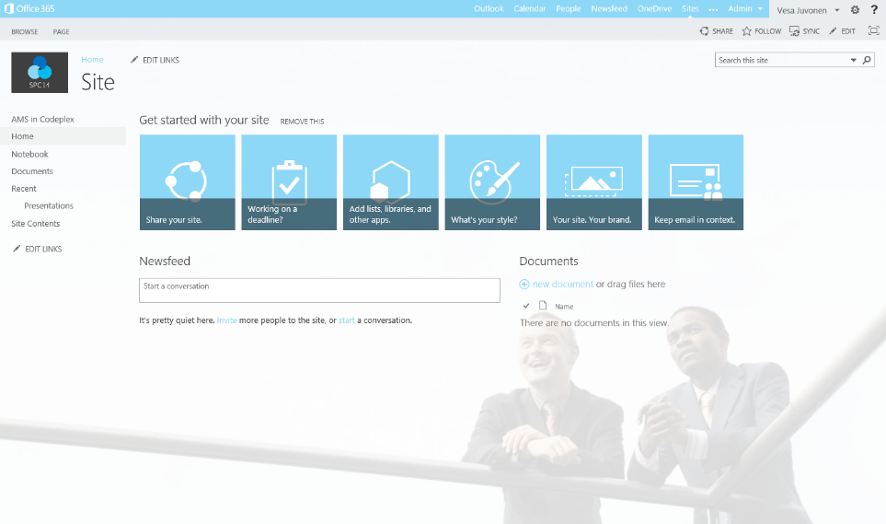
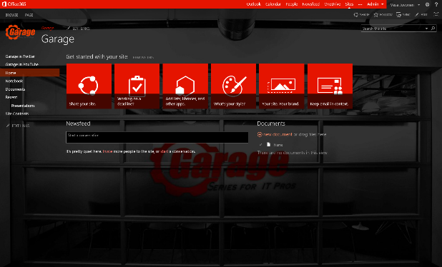
Recommended evergreen provisioning model without web templates
Initial provisioning based on the out of the box site. Usually either team site or publishing site.
Assets are uploaded from the provisioning engine using CSOM/REST
3
1
C#
Project site
2
Remote Timer job
3
Assets and configuration
Organizational
Branding Images
Master Pages
Page Layouts
Other settings
Apply the needed changes (configurations etc.) on top of the out of the box site based on the user selection.
This is the specialization part, but since we start from oob site, we always get the latest improvements to it as a base line.
3
Workgroup

Slide 25

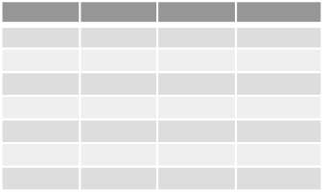
Async site collection provisioning
1
2
CSOM/REST
CSOM/REST
3
C#
Assets and configuration
CSOM/REST
Remote Timer job
4
5
Branding Images
Master Pages
Page Layouts
Other settings

Slide 26
Create site collections
Demo

Slide 27
Provision OneDrive for Business sites in the cloud

Slide 28
How Do Users Get Personal Sites?
Normal interaction with Office 365
Normal interaction with Office apps
Sign in to desktop apps
Run OneDrive sync client
Migration tools
Create, then push content
Bulk pre-create for large scale rollouts

Slide 29

Pre-create personal sites in cloud
What
Pre-create OneDrive for Business sites for specific accounts
Why
To avoid wait times when persons access the OneDrive for business first time or to perform pre-create sites to enable content migration for example from on-premises to the cloud
How
New APIs added to the cloud for SP2013 SP1. Can be called from CSOM or from REST interfaces

Slide 30
Requirements for pre-creation
This capability is available starting from CSOM version 16.0.2617.1200
You’ll have to use tenant administrator identity
Used CSOM components
Microsoft.Online.SharePoint.Client.Tenant
Microsoft.SharePoint.Client
Microsoft.SharePoint.Client.Runtime
Microsoft.SharePoint.Client.UserProfiles

Slide 31
Bulk Site Creation: New CSOM API in SP1
String _adminTenantUrl = "https://youradmin.sharepoint.com"; // You don't want to provision more than 200 users personal sites during a single request.
// If you have a large amount of users consider // waiting for the last users site to be provisioned. The reason behind this is not to bombard the service with requests. string _restPayload = "{'emailIDs':['user1@MicrosoftACS.onmicrosoft.com', 'user2@MicrosoftACS.onmicrosoft.com']}";
SharePointOnlineCredentials _creds = new SharePointOnlineCredentials(userName, Utilities.StringToSecure(password)); _context.Credentials = _creds; _context.ExecuteQuery(); ProfileLoader _profileLoader = ProfileLoader.GetProfileLoader(_context); _profileLoader.CreatePersonalSiteEnqueueBulk(emailIDs); _profileLoader.Context.ExecuteQuery();

Slide 32
Calling CSOM from PowerShell
$webUrl = "https://yoursharepointadmin.SharePoint.com"
$ctx = New-Object Microsoft.SharePoint.Client.ClientContext($webUrl)
$web = $ctx.Web
$username = "admin@myadmin.sharepoint.com"
$password = read-host -AsSecureString
$ctx.Credentials = New-Object Microsoft.SharePoint.Client.SharePointOnlineCredentials($username,$password )
[System.Reflection.Assembly]::LoadWithPartialName("Microsoft.SharePoint.Client.UserProfiles")
$loader =[Microsoft.SharePoint.Client.UserProfiles.ProfileLoader]::GetProfileLoader($ctx)
#To Get Profile
$profile = $loader.GetUserProfile()
$ctx.Load($profile)
$ctx.ExecuteQuery()
$profile
#To enqueue Profile
$loader.CreatePersonalSiteEnqueueBulk(@("user1@domain.com"))
$loader.Context.ExecuteQuery()

Slide 33
Create sub sites

Slide 34
Sub Site Creation with Apps
What
Create sub sites in the site collections using app pattern
Why
Provide alternative templates that are all based on out–of–the–box site definition, but can be altered based on customer requirements
Filter what options are shown for end users when they create sub sites
How
Native API support in CSOM
You can also override the out–of–the–box sub site creation experience with your app

Slide 35
Example Code to Create a Sub Site
// Create web creation configuration
WebCreationInformation information = new WebCreationInformation();
information.WebTemplate = “STS#0”;
information.Description = “This will be the description”;
information.Title = “Title for web”;
information.Url = txtUrl;
// Let’s set site language as English
information.Language = 1033;
Microsoft.SharePoint.Client.Web newWeb = null;
// Load host web and add new web to it.
Microsoft.SharePoint.Client.Web web = cc.Web;
cc.Load(web);
cc.ExecuteQuery();
// Let’s actually create the sub site
newWeb = web.Webs.Add(information);
cc.ExecuteQuery();
cc.Load(newWeb);
cc.ExecuteQuery();

Slide 36
Branded site collections automatically from the self-service site collection creation.
End users can just start using the sites as needed.

Slide 37
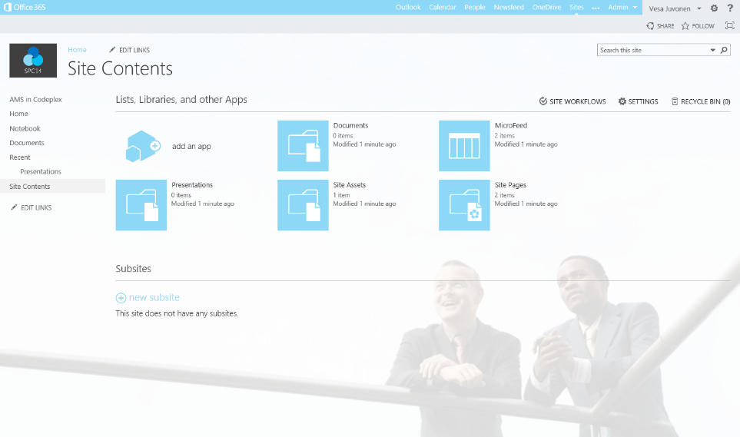
Familiar end user experience to start creating sub sites for the site collections.
Similar as out of the box experience.

Slide 38
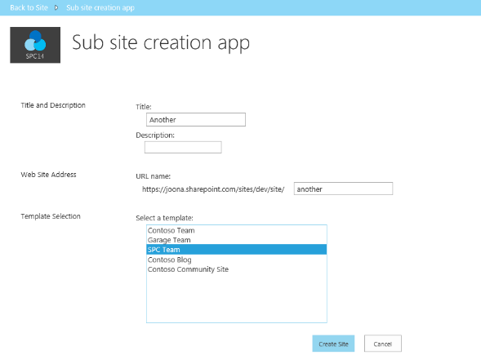
End user friendly and familiar template section for sub sites.
Options can be easily filtered based on business requirements

Slide 39
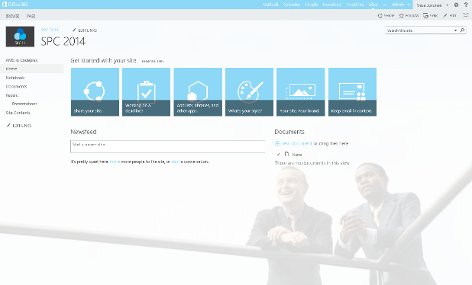
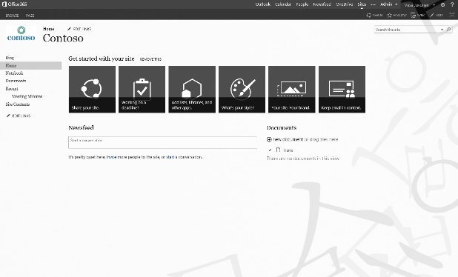
Consistent branding cross sites and site collections
Customer specific branding without customer master pages which would influence long term cost model.

Slide 40
Create sub sites
Demo

Slide 41
Permission management

Slide 42
Permission management
What
Set permissions on the created site collections and sub sites
Why
When site collections or sites are provisioned you might want to create additional groups with users and give them a permission to the site. Other common scenario is defining additional site collection administrators
How
Native API support in CSOM wrapped into easy to use Office AMS core extension methods

Slide 43
Example code to manage site collection administrators
// Adding administrators
List<UserEntity> adminsToAdd = new List<UserEntity>();
adminsToAdd.Add(new UserEntity() { LoginName = SAMPLE_USER_ACCOUNTNAME });
cc.Web.AddAdministrators(adminsToAdd);
// Removing administrators
UserEntity adminToRemove = new UserEntity() { LoginName = SAMPLE_USER_ACCOUNTNAME };
cc.Web.RemoveAdministrator(adminToRemove);

Slide 44
Example code to manage groups and users
// Adding group + adding user to group
Group group = cc.Web.AddGroup("Test", "Test group", true);
cc.Web.AddUserToGroup("Test", currentUser.LoginName);
// Remove group
cc.Web.RemoveGroup("Test");
// Remove user from group
cc.Web.RemoveUserFromGroup("Test", currentUser.LoginName);
// Add permission level to group or user
cc.Web.AddPermissionLevelToGroup("Test", RoleType.Contributor);
cc.Web.AddPermissionLevelToUser(currentUser.LoginName, RoleType.Reader);
// Remove permission level from group or user
cc.Web.RemovePermissionLevelFromGroup("Test", RoleType.Reader);
cc.Web.RemovePermissionLevelFromUser(currentUser.LoginName, RoleType.Reader);

Slide 45
Permission management
Demo

Slide 46
Approval workflow to creation

Slide 47
Workflow in SharePoint 2010
SharePoint 2010 hosted the Workflow Foundation (WF) Workflow runtime
Tightly coupled workflow to SharePoint 2010
Workflow data kept in SharePoint content databases
Challenges:
Designed for on-premises deployments (scale)
In SharePoint, extending WF meant you had to be a box admin
Analytics on current/previous workflow instances were hard to acquire
Executed in the context of SharePoint as a super user
Notes:
SharePoint 2010 capitalized on the Workflow Foundation (WF) found in the .NET Framework 3.5 SP1. There was not much difference in SharePoint 2010’s workflow story from SharePoint 2007 from an architectural perspective as SharePoint 2007 introduced workflow to the SharePoint platform via .NET Framework 3.0. The biggest improvements around workflow in SharePoint 2010 included:
Site-based workflows: Workflows that run within the context of an SPWeb (previously they could only run within the context of an SPListItem)
Power User Tooling Improvements:
Workflows could be modeled using Visio 2010 and exported/imported to SharePoint Designer 2010.
Added the ability to create reusable workflows or those that are tied to content types.
Added the ability to import reusable workflows into Visual Studio 2010 coded workflows.
Workflow Events: Override-able events developers can handle to run custom processes.
Workflows built for SharePoint were tightly coupled by SharePoint and ran at a very low level and were designed primarily for on-premises deployments.
This meant that coded workflows could not run within the sandbox or in a hosted environment.
All workflow data was also retained within the site collection’s content database where the workflow ran.

Slide 48

Workflow in SharePoint 2013
Workflow now treated as a service in SharePoint 2013
Moved to Workflow Manager
No longer runs in the content farm
No longer runs on SharePoint web front ends (WFE)/app servers
Harnesses the latest workflow technology from Microsoft
Workflow Manager available for on-premises deployments
Improves stability, scalability, and transparency
Notes:
SharePoint 2013 takes a very different approach to workflow. Existing SharePoint 2010 workflows will still run using the same legacy SharePoint 2010/.NET Framework 3.5 architecture and developers/users are free to continue creating workflows using this approach although it is not recommended.
SharePoint 2013 workflows are based on Windows Workflow Foundation 4.0 (WF), which has been substantially redesigned from earlier versions. WF, in turn, is built on the messaging functionality provided by WCF. The workflow story in SharePoint 2013 now treats workflow as a separate service and capitalizes on Workflow Manager which includes the WF included in .NET Framework 4.0. The workflow service provided by Workflow Manager is decoupled from SharePoint and no longer runs in the content farm—now it runs on its own servers. Workflow Manager also capitalizes on the latest and greatest advancements in workflow capabilities, performance, and scalability from Microsoft.
This new architecture is available both in the on-premises model using Workflow Manager as well as in a hosted model. By moving to this new architecture, SharePoint benefits from improvements in stability and scalability in the workflow platform. In addition, Workflow Manager is much more transparent where developers can use a service-based API to gain insight into metrics and analytics of WF.
Workflow Manager is very much a customer and capitalizes on the new SharePoint App Model architecture in that workflow (like apps) are treated as a “service.” SharePoint instructs Workflow Manager to execute a workflow and the two products communicate with each other over a service model infrastructure (WCF).

Slide 49
Uses for workflows in SharePoint apps
Model the way people do their work | Automate-monitor-improve a business process | Connect to other enterprise systems | Other middle tier operations
Example: Content creation, review, and publishing app | Example: Helpdesk app | Example: Integrate Dynamics CRM sales leads and SharePoint documents with workflow | Example: Look up and update sales tax on a product in a product catalog

Slide 50
Approval workflow to creation
Demo

Slide 51
Site metadata and classification

Slide 52
Work in progress

Slide 53
Site metadata and classification
Demo

Slide 54
Iterate and update “in-scope” site collections

Slide 55
Updating Existing Sites
What
Update branding and other settings in the sites after they are created based on new requirements
Why
It’s common that there has to be some adjustment done to the site sites, which have been previously created
How
Provision shared static elements like images, CSS files, and JavaScript files to one location and reference them from sites as needed with relative path
Loop through the sites and update them one by one using remote provisioning model

Slide 56


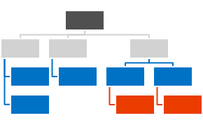



Centralized Asset Deployment
https://Contoso.sharepoint.com /sites/site
https://Contoso.sharepoint.com
<<Reference>>
3
https://Contoso.sharepoint.com /sites/site2
1
<<Reference>>
2
<<Reference>>
Assets and Configuration
https://Contoso.sharepoint.com /sites/site3
Branding Images
Master Pages
Page Layouts
Other settings
Notes:
Static assets like images, JS files, and CSS files are deployed together with the master page and asp files to the root site collection of the a web application or a tenant.
Dynamic files like master pages and other asp pages are deployed to the each site collections.
Static files are referenced from the root site collection using relative links.
Provides one location to change most of the functionalities and there’s no need to deploy all the image, CSS, or JS files to each of the site collection.

Slide 57
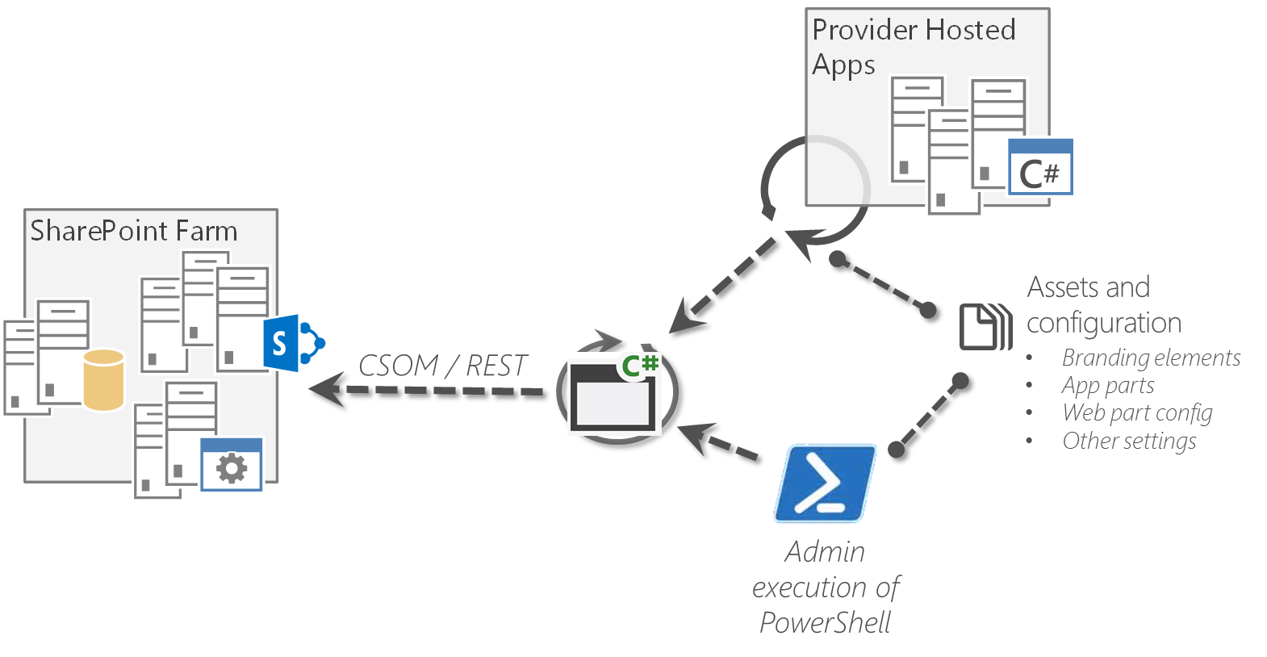
Updating Branding Afterwards Reference architecture
Place logic to reusable component, which can be called from the app and from other solution
Provides reusability and easy maintenance

Slide 58
Sample for iteration and update “in-scope” site collections
Demo

Slide 59
Remote event receiver based modifications

Slide 60
Remote event receivers
What
Process events from SharePoint using custom code
Why
To react on user or customization actions done in the host web
Old pattern was created by event receivers with server-side code
How
Create remote event receivers
Registration can be done either using server-side or client-side code
External web service is called when events in host web occur

Slide 61
Remote event receivers
SharePoint is increasingly acting as a data hub
In previous versions, there was no way to inform external systems of events
Highly-requested capability by customers, now included in SharePoint2013
External lists also support events
Notes:
SharePoint is increasingly used as the hub for productivity and collaborative experiences that incorporate and interact with data from a variety of external systems. Capabilities like those offered by Business Connectivity Services offer a powerful infrastructure for surfacing external data inside SharePoint, and SharePoint web services offer an increasing complete set of options for surfacing SharePoint data in outside systems.
SharePoint does not, however, currently provide a convenient mechanism for informing external systems of SharePoint events. As a result it is effectively impossible to build an efficient solution that reacts to changes in SharePoint data, except through complex, farm-deployed solutions that use custom event receivers and web service interfaces to call into external systems. Given that farm-deployed solutions are not allowed in Microsoft SharePoint Online, even this solution is not available to Office 365 customers.
In addition, the current sandboxed solution infrastructure imposes quite a few restrictions on the developer. For example, solutions cannot execute for longer than 30 seconds, and they cannot exceed a certain amount of resource usage per day. Allowing a developer to execute their event receiver logic outside of the SharePoint farm makes it possible for them to overcome these restrictions and build more robust solutions.
This was one of the most highly requested features: providing support for external systems to receive events from SharePoint so they can take action based on that event. There are also enhanced capabilities in Business Connectivity Services (BCS) to allow external systems to receive information. We are not talking about BCS in this module—we will talk about that in the BCS module in this course. If you have developed event receivers before, you will find this very familiar and you will be able to take advantage of your skills with this model.

Slide 62

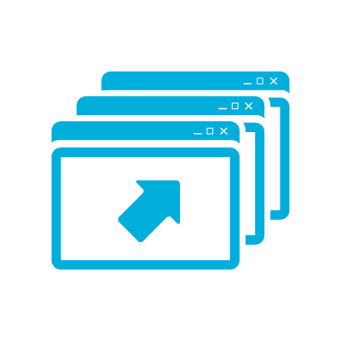








Remote event receivers
3. Registered event receiver called
4. Line of business system is updated
Custom Web Service
5. Event receiver returns
1. User updates SharePoint list
External System
SharePoint
Users
ACS
2. SharePoint requests a token from ACS
1
Notes:
SharePoint executes events in the following order:
1. Synchronous “before” events in sequence order
2. Synchronous “after” events in sequence order
3. Asynchronous “after” events
Custom web services implement a required interface and register for events.
The custom web service can perform any required action and then call back into SharePoint.
1. When a user interacts with a supported artifact, then an event fires.
2. SharePoint requests ACS to create and sign a token which contains context information about the current user along with an authorization code.
3. SharePoint calls the registered event received (a web service) and passes the context token. The web service validates the signature on the context token and extracts the authorization code.
4. The event receiver can do anything it wants. In this case, updating a line of business (LOB) system.
5. The event receiver returns a code to SharePoint indicating the outcome of the event.

Slide 63
Remote event receivers – callback
3. Registered event receiver called
4. Line of business system is updated
Custom Web Service
6. Event receiver calls back into SharePoint
1. User updates SharePoint list
External System
SharePoint
5. Event receiver requests a token from ACS
Users
ACS
2. SharePoint requests a token from ACS
Notes:
1. When a user interacts with a supported artifact, then an event fires.
2. SharePoint requests ACS to create and sign a token which contains context information about the current user along with an authorization code.
3. SharePoint calls the registered event received (a web service) and passes the context token. The web service validates the signature on the context token and extracts the authorization code.
4. The event receiver may perform any action it needs to such as updating a system hosted in the cloud.
5. The remote event receiver requests a token from ACS that it can use to call back into SharePoint.
6. The remote event receiver can use the token to call back into SharePoint and perform a task.

Slide 64
Remediation activities
Event scopes:
List item
Support for the following types:
Synchronous events
List
Web
App
Asynchronous after events
Notes:
Title: Remediation activities
Timing: 1 minute

Slide 65
Remote event receivers – architecture
Not a good choice for “mirroring” or sync solutions
Use remote event receivers to receive notification that a change has occurred
Use interface to poll SharePoint for changes
Write changes as required
No guaranteed delivery
Custom code can help improve delivery
Issues in network could block the execution and there’s no retry mechanism
Notes:
Remote event receivers are not good for mirroring or sync solutions. We have seen where people have tried to use event receivers to synchronize data between farms or to update databases when data is changed. These are not good uses of event receivers in either model, but particularly with remote event receivers because there is no guaranteed delivery. You will not have that message queued up for delivery and then you will wait for the remote endpoint to come back online to continue processing. The remote endpoint has to be online and listening for the delivery to occur. You can write some custom code to try to improve this, but you do not receive that out of the box.

Slide 66
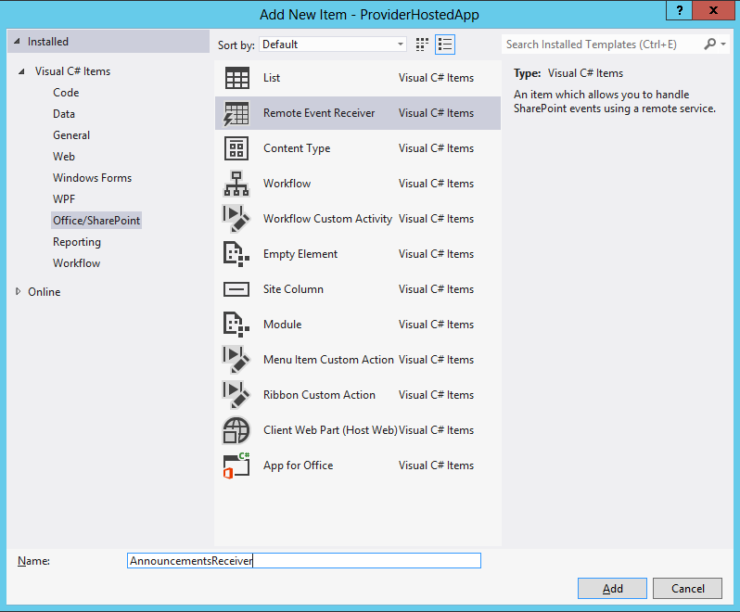
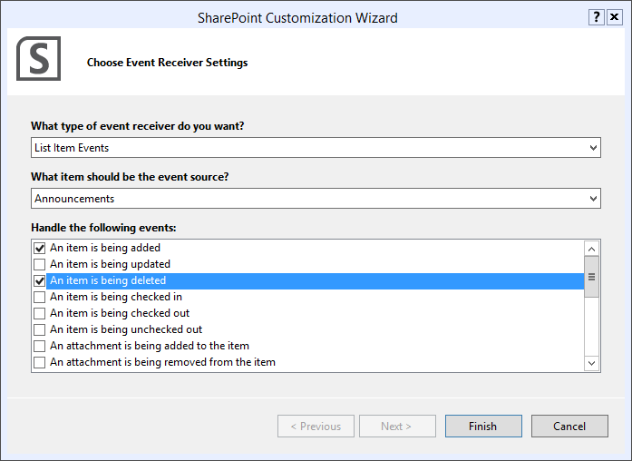
Remote event receivers – tooling
Add a remote event receiver as a new item
Note: This wizard is only for events in app web.
Notes:
Remote event receivers can be added directly to app projects.

Slide 67
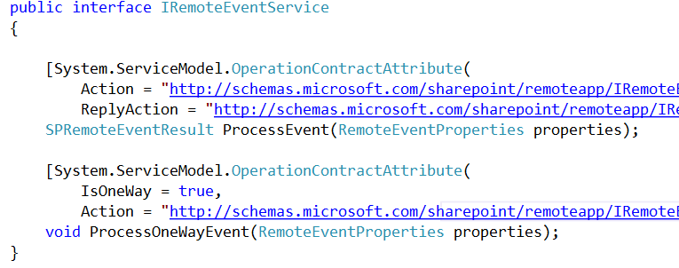
Remote event receivers – interface methods
Synchronous and asynchronous events are supported
Notes:
ProcessEvent
The defined interface supports “ING” events and synchronous “ED” events. ING events occur before the actual event, such as the actual adding of an item to a list or the actual deleting of an item in a list. In this version of SharePoint, we can also specify the ED events, meaning notification after the event has occurred—we can specify that the call is processed synchronously.
ProcessOnewayEvent
The defined interface supports asynchronous “ED” events.
The web service takes a single argument of type SPRemoteEventProperties and returns SPRemoteEventResults for synchronous events.
The web service takes a single argument of type SPRemoteEventProperties and returns void for “ED” events.
SPRemoteEventProperties will always pass an EventType property, which describes the type of event that is occurring or has occurred. In addition, one of ItemEventProperties, ListEventProperties, or WebEventProperties will be passed, depending on the EventType.
For “ING” events, the web service will respond with an object of type SPRemoteEventResult, which will specify the status of the event and, if applicable, the list of changed properties, an error message, and/or a redirect URL.
The remote event receiver web service caller will only support calling SOAP-based web services.
The web service caller will use XML serialization.
The web service caller will depend on the outbound Oauth authentication scheme.

Slide 68
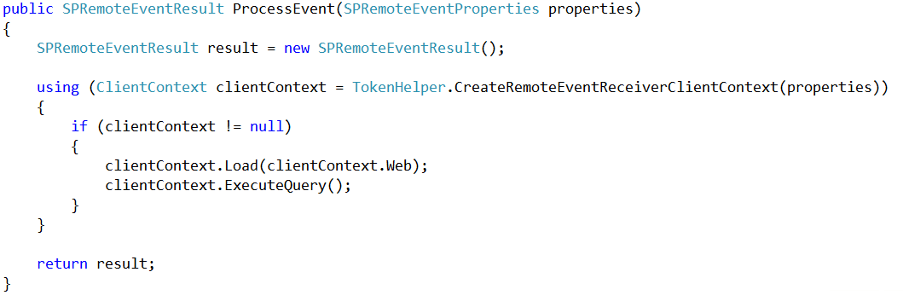
Remote event receivers
Calling back into SharePoint
Notes:
The boilerplate code that is generated by Visual Studio looks similar to the code above. We use the CreateRemoteEventReceiverClientContext method of the TokenHelper class to obtain a client context based on the context token that is passed to the WCF service. The end result is that you will have a client context that will be used to call back into SharePoint, making advanced scenarios possible where we call back into SharePoint for further processing. The system used to call back into SharePoint, security tokens, and Oauth are not covered in detail in this module—we will review these in another module. In this module, we just want to focus on the fact that it is possible to retrieve the token to be used to make a call back into SharePoint.

Slide 69
Remote event receivers – registration Using server-side object model – requires access to server
string url= "http://contoso.com/RemoteEventService.svc";
using (SPSite site = new SPSite(siteUrl))
{
using (SPWeb web = site.RootWeb)
{
SPList list = web.Lists[listTitle];
list.EventReceivers.Add(
SPEventReceiverType.ItemAdded,
url);
}
}
Notes:
The object model associated with remote event receivers functions identically to SPEventReceiverDefinition, except that it will have an additional URL property, and the Assembly and Class properties will not be used.

Slide 70
Remote event receivers – registration Client-side object model implementation
var web = clientContext.Web;
clientContext.Load(web);
clientContext.ExecuteQuery();
var col = web.EventReceivers;
clientContext.Load(col);
clientContext.ExecuteQuery();
EventReceiverDefinitionCreationInformation newEventReceiver
= new EventReceiverDefinitionCreationInformation()
{
EventType = EventReceiverType.ListAdded, ReceiverName = "CustomRemote-ListEventReceiver",
ReceiverUrl = remoteEventUrl, SequenceNumber = 1000
};
web.EventReceivers.Add(newEventReceiver);
clientContext.ExecuteQuery();
Notes:
The object model associated with remote event receivers functions identically to SPEventReceiverDefinition, except that it will have an additional URL property, and the Assembly and Class properties will not be used.

Slide 71
Sample for the Remote event receiver based modification
Demo

Slide 72
Pre-created OneDrive for Business sites

Slide 73
How Do Users Get Personal Sites?
Normal interaction with Office 365
Normal interaction with Office apps
Sign in to desktop apps
Run OneDrive sync client
Migration tools
Create, then push content
Bulk pre-create for large scale rollouts

Slide 74
Pre-create personal sites in cloud
What
Pre-create OneDrive for Business sites for specific accounts
Why
To avoid wait times when persons access the OneDrive for business first time or to perform pre-create sites to enable content migration for example from on-premises to the cloud
How
New APIs added to the cloud for SP2013 SP1. Can be called from CSOM or from REST interfaces

Slide 75
Requirements for pre-creation
This capability is available starting from CSOM version 16.0.2617.1200
You’ll have to use tenant administrator identity
Used CSOM components
Microsoft.Online.SharePoint.Client.Tenant
Microsoft.SharePoint.Client
Microsoft.SharePoint.Client.Runtime
Microsoft.SharePoint.Client.UserProfiles

Slide 76
Bulk Site Creation: New CSOM API in SP1
String _adminTenantUrl = "https://youradmin.sharepoint.com"; // You don't want to provision more than 200 users personal sites during a single request.
// If you have a large amount of users consider // waiting for the last users site to be provisioned. The reason behind this is not to bombard the service with requests. string _restPayload = "{'emailIDs':['user1@MicrosoftACS.onmicrosoft.com', 'user2@MicrosoftACS.onmicrosoft.com']}";
SharePointOnlineCredentials _creds = new SharePointOnlineCredentials(userName, Utilities.StringToSecure(password)); _context.Credentials = _creds; _context.ExecuteQuery(); ProfileLoader _profileLoader = ProfileLoader.GetProfileLoader(_context); _profileLoader.CreatePersonalSiteEnqueueBulk(emailIDs); _profileLoader.Context.ExecuteQuery();

Slide 77
Calling CSOM from PowerShell
$webUrl = "https://yoursharepointadmin.SharePoint.com"
$ctx = New-Object Microsoft.SharePoint.Client.ClientContext($webUrl)
$web = $ctx.Web
$username = "admin@myadmin.sharepoint.com"
$password = read-host -AsSecureString
$ctx.Credentials = New-Object Microsoft.SharePoint.Client.SharePointOnlineCredentials($username,$password )
[System.Reflection.Assembly]::LoadWithPartialName("Microsoft.SharePoint.Client.UserProfiles")
$loader =[Microsoft.SharePoint.Client.UserProfiles.ProfileLoader]::GetProfileLoader($ctx)
#To Get Profile
$profile = $loader.GetUserProfile()
$ctx.Load($profile)
$ctx.ExecuteQuery()
$profile
#To enqueue Profile
$loader.CreatePersonalSiteEnqueueBulk(@("user1@domain.com"))
$loader.Context.ExecuteQuery()

Slide 78
Pre-Create OneDrive for Business sites
Demo

Slide 79
App Stapling / SideLoading

Slide 80
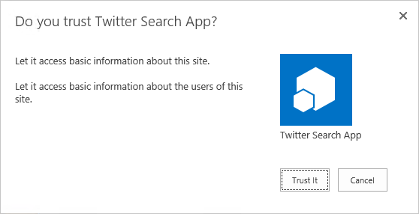
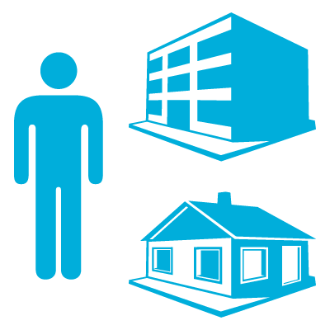

Apps in site collection hierarchy
1
3
https://*.contosoapps.com
2
2
APP
4
https://intranet.contoso.com/sites/team
4
Root
https://intranet.contoso.com/sites/groupx
Root
Sub site
AppWeb
News
Organization
Teams
Search
AppWeb
Notes:
Shows the difference app web instances cross site collections.

Slide 81
Centrally deployed app
1
https://*.contosoapps.com
2
3
https://intranet.contoso.com/sites/catalog
APP
Root
https://intranet.contoso.com/sites/team
AppWeb
AppWeb
Root
4
Sub site
https://intranet.contoso.com /sites/orgZ
4
Root
News
Organization
Teams
Search

Slide 82
Centrally deployed apps capabilities
Deployed from app catalog
Define the rules where app is deployed – “app stapling”
Specific site collections
Specific managed path
Specific template
App stapling is applied to existing and new sites
Provides capability to ensure that specific apps are available to each site collection in tenant or in farm level (on-premises)
Some limitations though
Custom actions and app parts are not supported

Slide 83
Centrally deployed vs. side loading
Centrally deployed
App web actually created under app catalog site collection
You can control app to be visible in site contents using multiple different settings
For example by template or by URL
Not supported to apply app parts to the webs where stapled in
No support also for app custom actions
Centralized way to control app being available or to remove it
With UI capabilities
Application install/uninstall events do not fire when deployed to sites
Side loading
Supports adding app parts and app custom actions to host web
Requires specific feature to be enabled from host web for app installation
No centralized control to add or remove the app
No UI to deploy the app cross sites
Application install/uninstall events do fire when deployed to sites

Slide 84
Example Code for SideLoading
Guid _sideloadingFeature = new Guid("AE3A1339-61F5-4f8f-81A7-ABD2DA956A7D");
Try{
_site.ProcessFeature(_sideloadingFeature, true);
try{
var _appstream = System.IO.File.OpenRead(_path);
AppInstance _app = _web.LoadAndInstallApp(_appstream);
_ctx.Load(_app);
_ctx.ExecuteQuery();
}
_site.ProcessFeature(_sideloadingFeature, false);
catch {
throw;
}

Slide 85
SideLoading Rules of the Road
No SharePoint Hosted Applications
SharePoint Provider Hosted Applications
Still must registered App Principals once for Tenant level using appinv.aspx
Must be a Tenant Admin or Farm Admin to enable SideLoading Feature
Disable SideLoading Feature when done!!!
Must have a user context

Slide 86
Sample for the SideLoading
Demo

Slide 87


© 2014 Microsoft Corporation. All rights reserved. Microsoft, Windows, and other product names are or may be registered trademarks and/or trademarks in the U.S. and/or other countries.
The information herein is for informational purposes only and represents the current view of Microsoft Corporation as of the date of this presentation. Because Microsoft must respond to changing market conditions, it should not be interpreted to be a commitment on the part of Microsoft, and Microsoft cannot guarantee the accuracy of any information provided after the date of this presentation. MICROSOFT MAKES NO WARRANTIES, EXPRESS, IMPLIED OR STATUTORY, AS TO THE INFORMATION IN THIS PRESENTATION.

